Slide 1

Zscaler + Prospect Medical High Level Architecture
Brian Deitch, SA September 7, 2020
Notes:
Thanks and confirm time

Slide 2
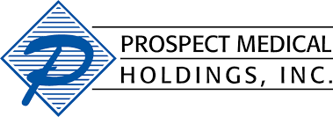
Executive Sponsor: Andy Fuss, CISO
STRATEGIC ALIGNMENT
PMH is looking to consolidate their overall environment & improve their security posture
CURRENT STATE OF SECURITY
SECURITY REQUIREMENTS
SIMPLE. SECURE. SMART.
KEY CHALLENGE:
The ability to increase security while not impacting user experience.
SOLUTION ALIGNMENT:
Ability to provide a full security suite including TLS/SSL inspection and remote access with one client.
OVERALL IMPACT:
Increase in security posture with users protected regardless of device or location without increasing time and additional activities for the security team.
NEGATIVE CONSEQUENCES:
Currently using Cisco Umbrella & AnyConnect to secure users “working from anywhere”
Only inspecting 10% of traffic - No SSL
No DLP policy implemented to protect PII & NPII data
VPN used as needed for internal app access due to performance so security measures aren’t always in place
Holes in current security toolset - CASB, DLP, Sandbox
CRITICAL CAPABILITIES:
The ability to inspect 100% of traffic at scale as LoanDepot grows (adding 300 to 400 employees per week)
”Combine 6 different control points and services into 1 with minimal manpower and minimum ops support”
Integration with O365 to remove current admin time for weekly updates
Provide seamless & secure access to applications for corporate and 3rd party business users
Remote network access, make applications “dark” & close attack vectors
EXPECTED OUTCOMES:
Increase percentage of SSL inspected traffic and integrated DLP
Reduction in time and effort when utilizing a single security platform
Operational steady state, and control effectiveness with a single solution
With the deployment of the Zscaler Client Connector security policies are always applied
Remove network access, make applications “dark”, and close attack vectors.
QUANTIFIED IMPACT:
90% of TLS/SSL traffic not inspected
Recent VPN outage impacted 3,000 for a full day = $10M
SOC Team investigating 10 to 15 incidents per week
TYPICAL CUSTOMER SAVINGS:
Admin time involved in forklift migrations - 20 people, 2 -3 meetings per week for 3 months
X in savings solely for product cost
Cost savings of a security incident with users now covered 100% from any location.
MEASURED IMPACT:
Ability to provide full security suite and remote access with 1 client
Lower costs due to the replacement of 6 solutions with 1
Seamlessly allow users to work from anywhere

Slide 3






PHM Current
Corporate Users
Hub and spoke
Users off net without VPN are unprotected
Zero visibility into cloud shadow IT
Recent Ransomware attack
Current Initiatives
CA
NJ/RI
DC consolidation
Consistent security policy when users are on/of net
Minimize or completely eliminate ransomware attacks
Adoption of SDWAN
DC Apps
PA
HQ/IOT
CT
Hub-and-Spoke Network

Slide 4
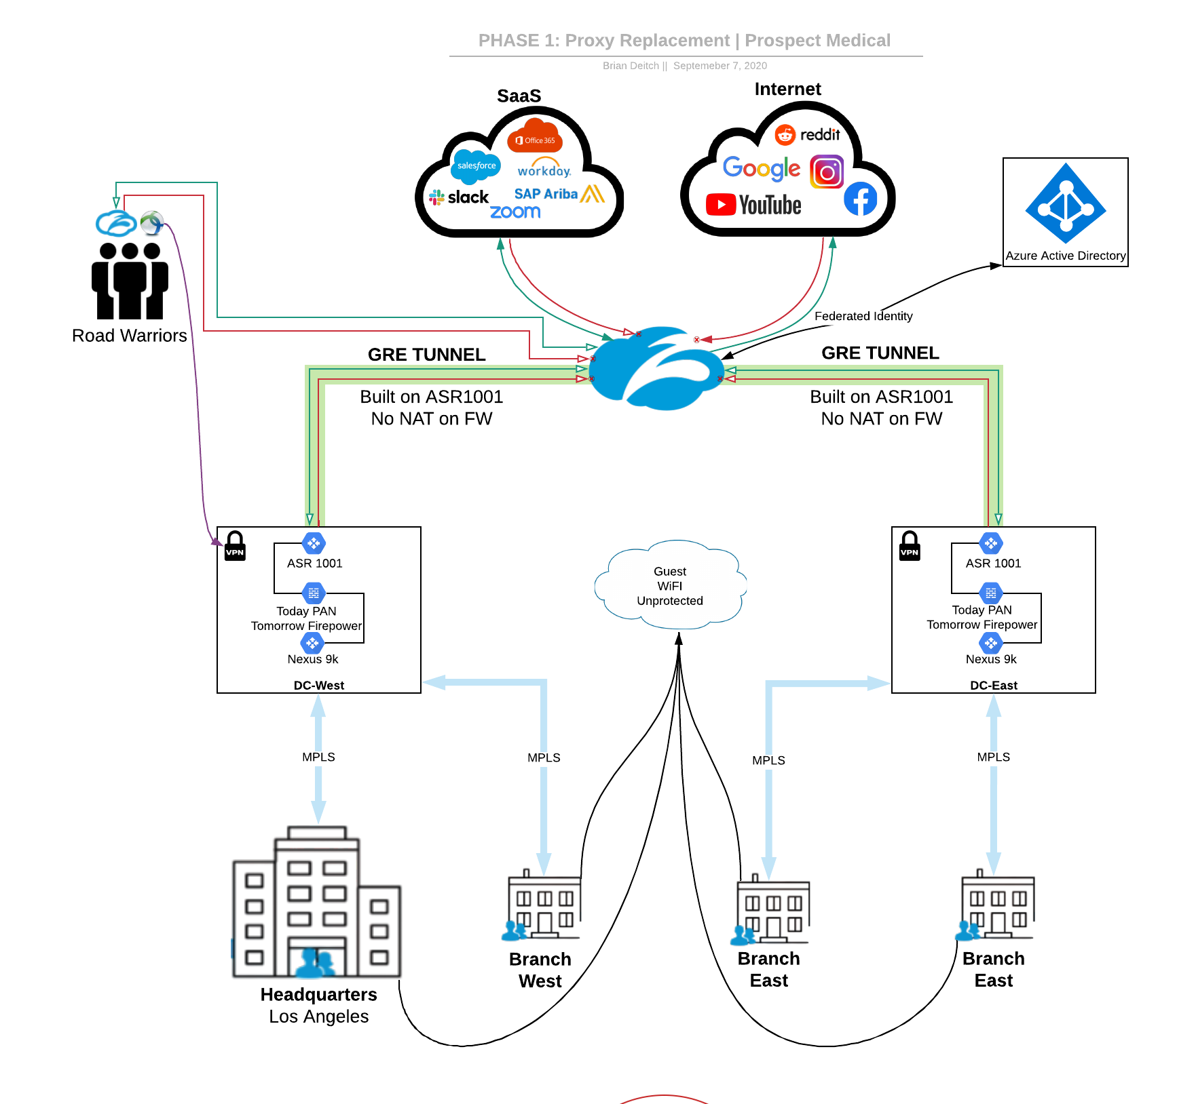
PMH Phase 1: Proxy Replacement
Central Egress
Make Zscaler work with Hub & Spoke
Build Tunnels from West/East Datacenters
Tunnels built on perimeter (ASR1k)
No NAT on PAN firewall
Guest wifi unprotected
Possible onboard Guest Wifi
Identity
Federated Identity with Azure AD
No MFA for ZIA (Duo Existing)
Lucidchart version is available here (view only).

Slide 5
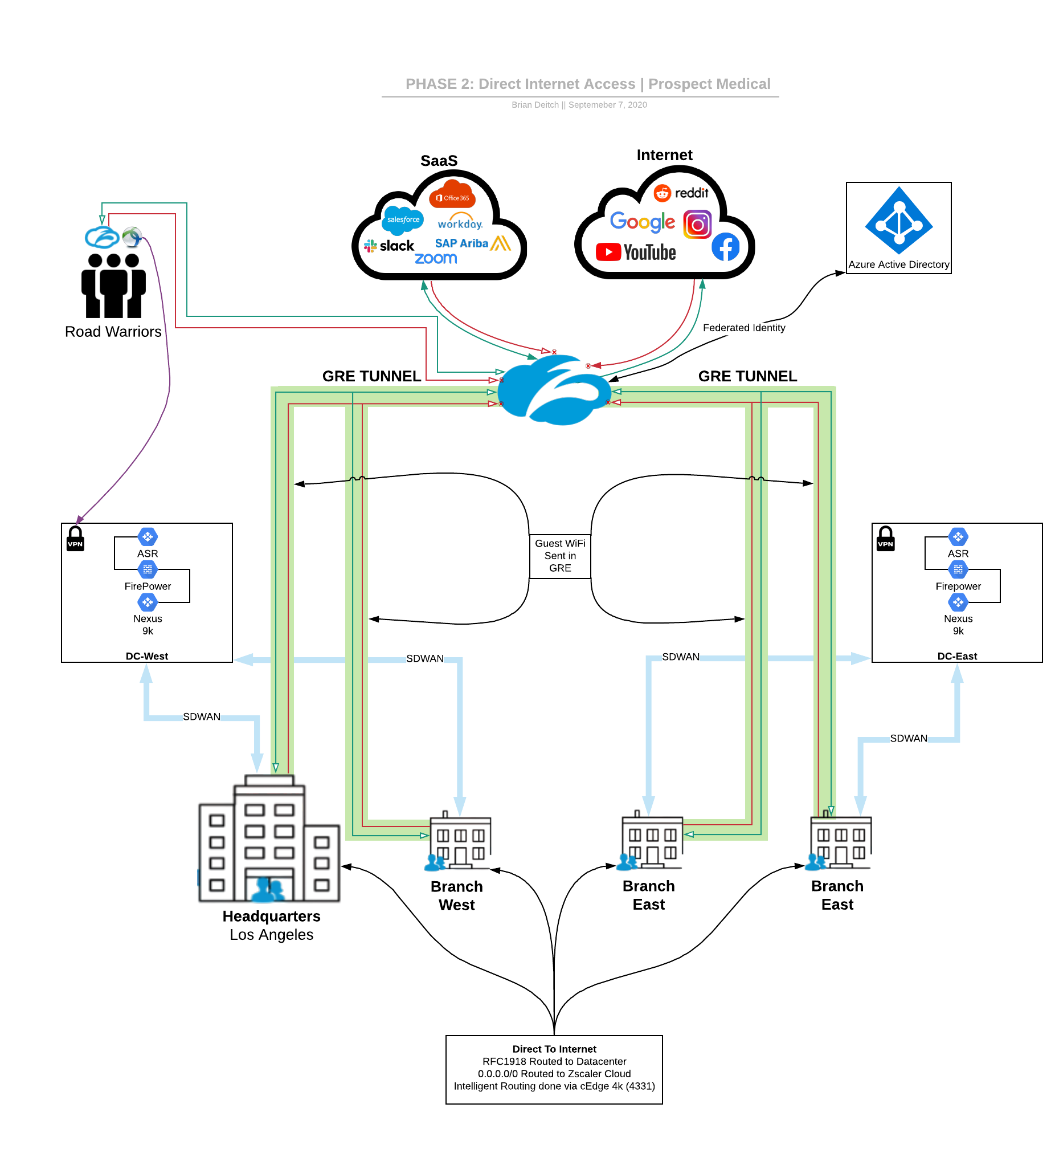
PMH Phase 2: DIA
DIA
Move from hub and spoke
Leverage intelligent traffic steering with cEdge
RFC 1918 to DC
0.0.0.0 to Zscaler
Optional: Include Guest Wifi
Note: User with Zscaler Client Connector will be protected on Guest WiFi
Lucidchart version is available here (view only).

Slide 6
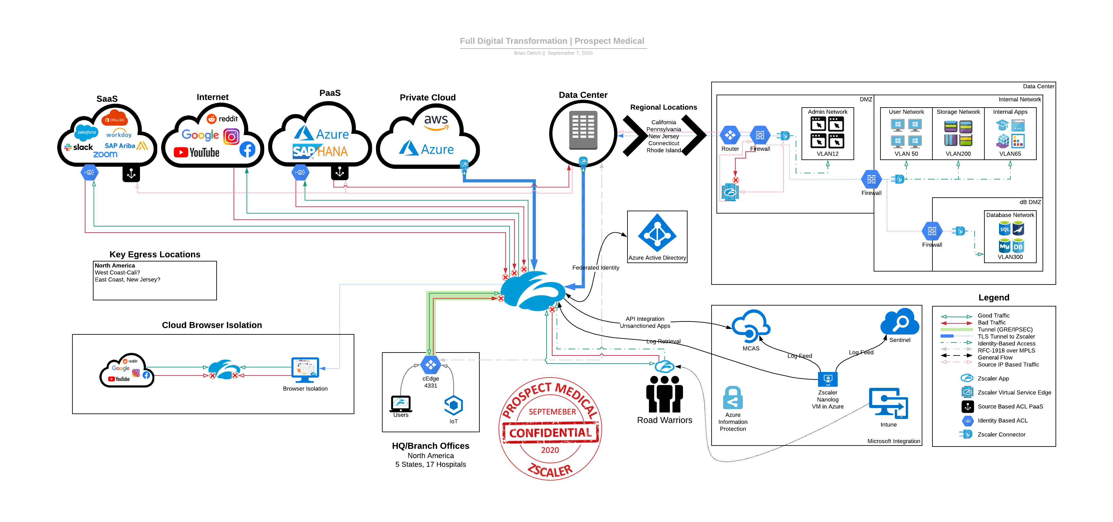
PMH Transformed
Lucidchart version is available here (view only).

Slide 7
PHM ZIA+ZPA Work From Anywhere
Fast
No more backhaul
User are connected to closest app
Seamless authentication integration ensure users can quickly access applications
M&A goes from years to months
Secure
User traffic is always inspected
SSL/TLS Inspection provides visibility into traffic and allows the good but stops the bad
Users are always protected
Access is predicated on identity and nothing is assumed
Consistent
Internet and SaaS applications are applied regardless of locations
Access to internal applications as if they were on the network but from anywhere
Standardization reduces risk

Slide 8

Digital Transformation Journey
BUSINESS |  |  |  |  | Digital Experience | App to App Micro segmentation Cloud Posturing
APPLICATION |  |  |  | Internet as Corporate Network | Visibility & Analytics on every user action Simplified App DevOps and delivery ZPA Globally | Embrace zero trust for cloud to cloud as well as app to app for legacy data center
NETWORK |  |  | Local Internet Breakouts | 100% SASE Segmented DC – Dynamic | Visibility into all aspects of connectivity by user and location | Segmentation done on a per app level, unprecedented visibility and control Policy & governance
SIMPLIFY |  | Remove Legacy | Auto Scale Capacity Reduce Ops | MPLS Savings $M+ Operational Mgmt Retire AnyConnect | Improved Troubleshooting Employee Experience | Align all IT spend to actuals Reduced downtime, M&A integration cost/time Retire CorpWAN/LAN Retire on prem firewalls, portals
SECURE | Cloud Proxy | Retire PAN URLF Partner with AnyConnect | Expand Egress to other locations DIA from Local Branch | Inline CASB controls Data Protection Workshop | Privacy & GDPR Risk Posture ++ | App based ACLs Security, Data Privacy, and Compliance Assurance
 |  | CY20Q3 | CY20Q3/4 | 2021 | 2021/2022 | 2022

Slide 9
Thank You

